Slide 1
Ethohand II: Development and Control of a Dexterous Robotic Hand
Munir Suleman
MSc Human and Biological Robotics
Imperial College London
Supervisor: Dr Aldo Faisal
Co-supervisor: Charalambos Konnaris

Slide 2
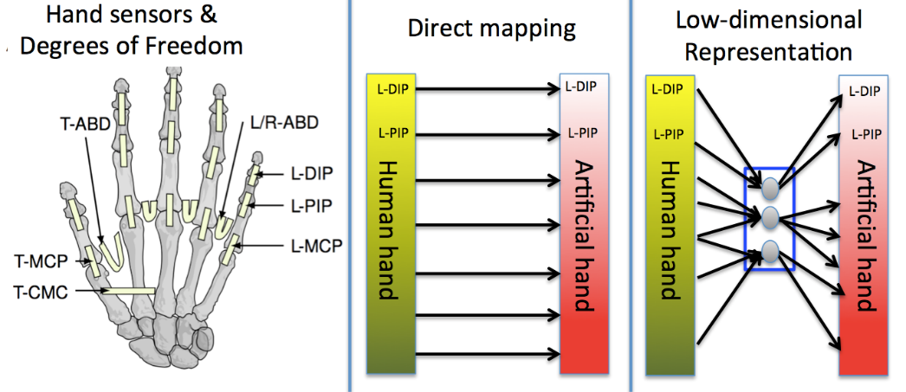
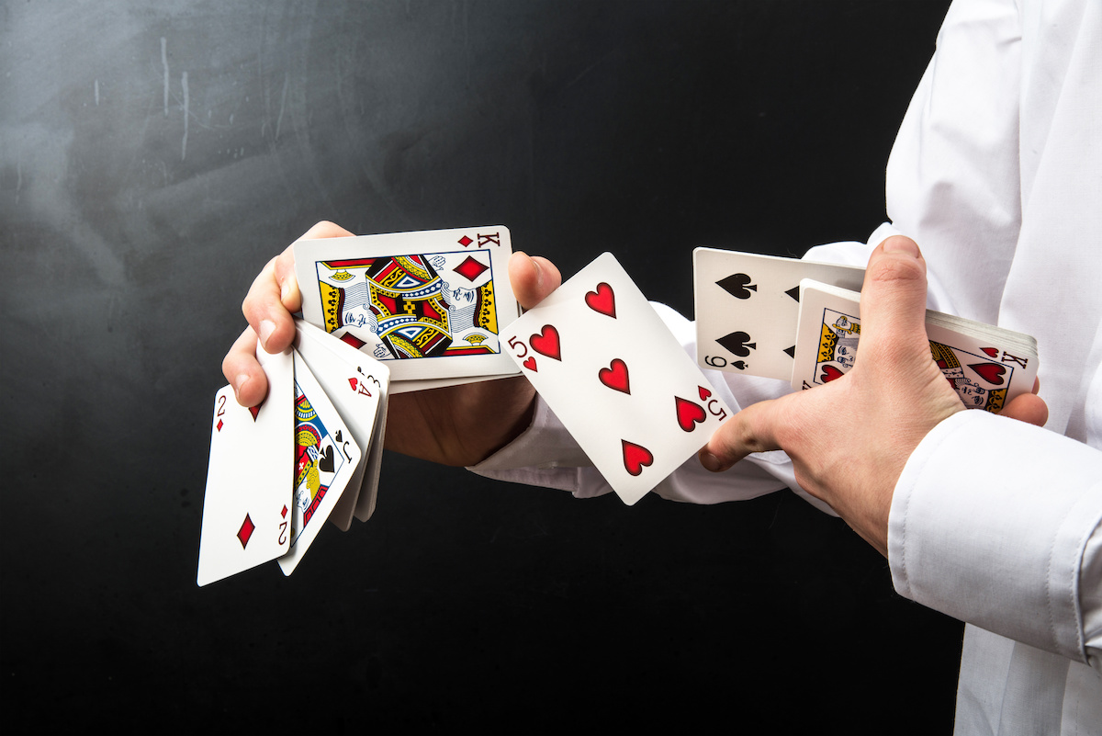
Background
Human hand = 22 Degrees of Freedom (DoF)
Dexterity of the human hand [1]
Dimensionality reduction would allow control of a higher amount of DoF
[1] http://images.ctfassets.net/3s5io6mnxfqz/4acmfUaKRfNK1oB8q2ZVbi/bfa206f93949e3173946161d13668187/AdobeStock_75868527.jpeg
Notes:
When we think about the perfect tool or more specifically the perfect end-effector, we want it to be adaptable, functional, dexterous, and for that it is hard to look past the end-effector we use everyday; the human hand. It is ideal for grasping and object manipulation due to its high dexterity and 22 DoF and its is also our primary interaction with the world. So it goes without saying losing a hand becomes a severe handicap for the amputees. So from there came the development of prosthetics to try and restore some of the functionality of the lost hand but then we have the issue of control. Ideally we want it to be as natural as possible so as technology advanced prosthetics started to use EMG signals from the arm muscles to control the robotic hand but this has its limitations due to only a few signals trying to control 22 DoF. Thus began the research into dimensionality reduction from myoelectric signals from the arm to controlling large amounts of DoF in robotic hands.

Slide 3
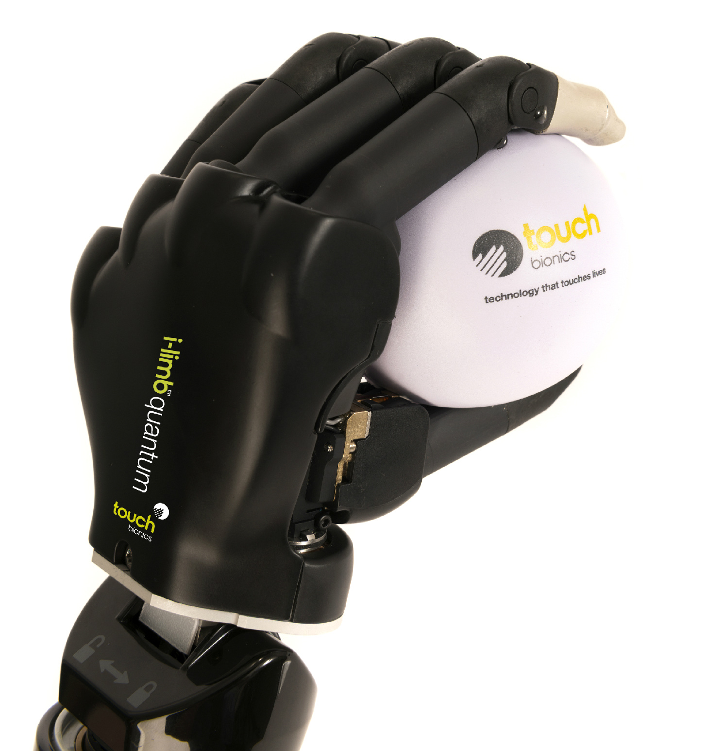
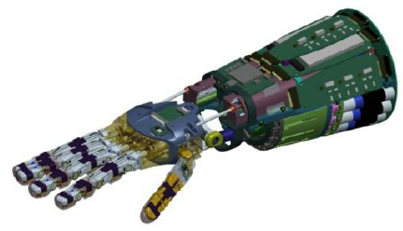
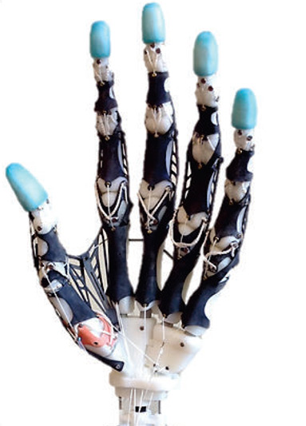
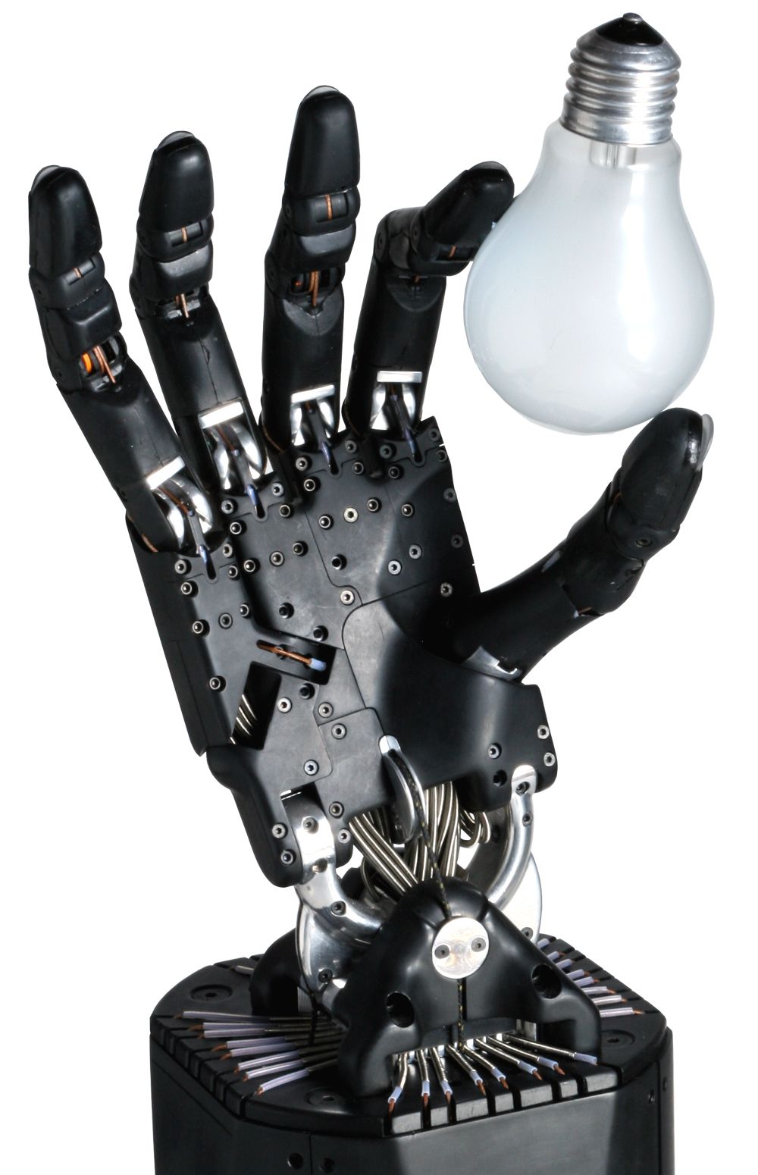
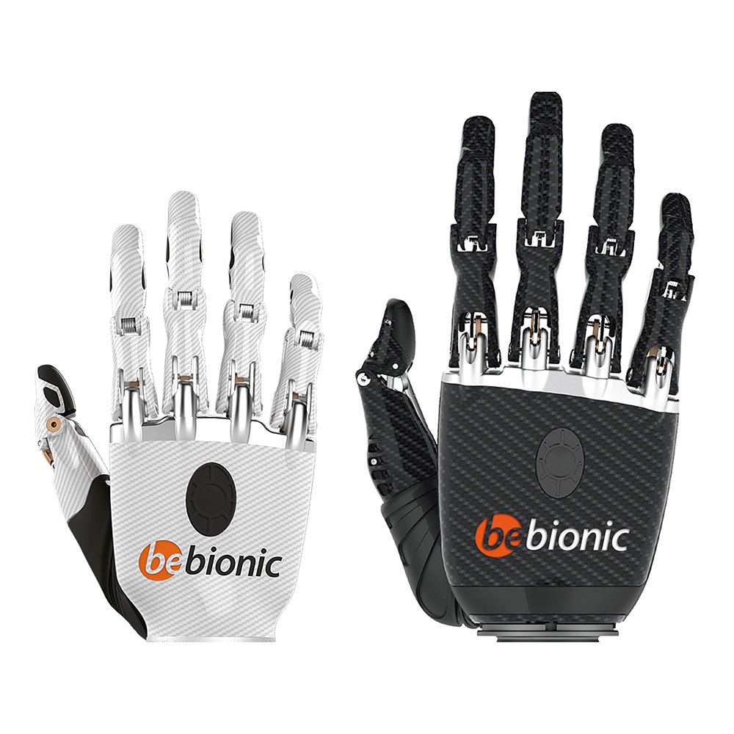
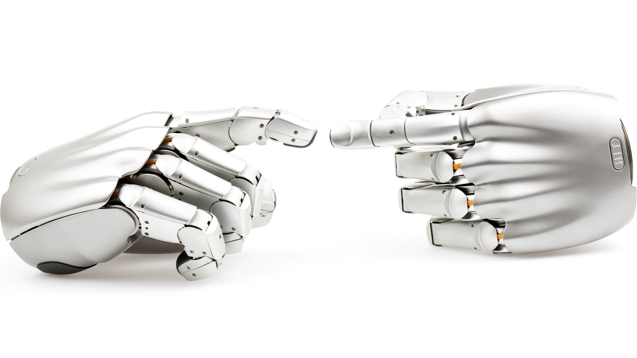
Purposes of Robotic Hands
Prosthetics
Industry
Research
Biomimetic Anthropomorphic Hand [4]
Robonaut 2 [2]
Touch Bionics (2015)
Shadow Robotics Company (2005)
Bebionic (2011)
DLR/HIT Hand II [3]
[2] L. B. Bridgwater et al., "The Robonaut 2 hand - designed to do work with tools," IROS, 2012
[3] H. Liu et al., "Multisensory five-finger dexterous hand: The DLR/HIT Hand II," IROS, 2008
[4] Xu, Todorov, "Design of a highly biomimetic anthropomorphic robotic hand towards artificial limb regeneration," ICRA, 2016
Notes:
But prosthetics like the iLimb and Bebionic hands, aren’t the only practical use for robotic hands. There’s also uses in space since there are areas where a human cant go and instead can teleoperate a robotic hand/arm to carry out tasks. Or in areas of manufacturing where the robot can carry out tasks humans can and cant do without tiring. Or more simply just for research to see what is achievable in trying to replicate the human hand like the Shadow Robotics hand. However an area that has always been difficult to replicate is the thumb due to its unique kinematics. Which brings me the original Ethohand.

Slide 4
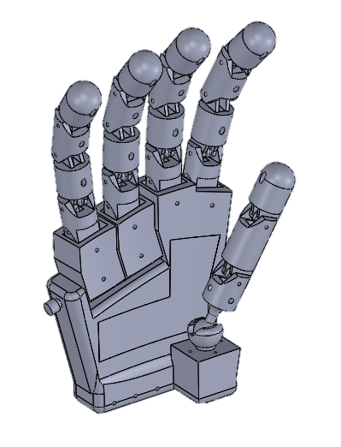
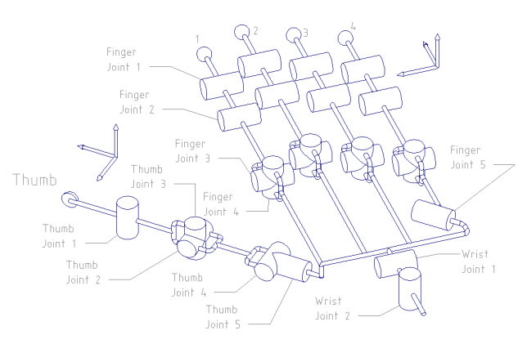
Ethohand I [5]
Innovation: Ball-joint thumb
Typically: Double Hinge Joint
Ethohand I (2016)
Shadow Robotics Company (2005)
[5] C. Konnaris et al., "EthoHand: A dexterous robotic hand with ball-joint thumb enables complex in-hand object manipulation," BioRob, 2016
Notes:
The main innovation for the original Ethohand was the use of a ball-joint to move the base of the thumb. Typically robotic hands use a double hinge joint as its relatively easy to control but this requires 2 joints for 2 DoF, where as a ball joint has both in just one joint. It is also more representative of the saddle joint in the human hand which allows for palmar and radial abduction. But the ball joint complicates the control aspect. The human hand has 22 DoF as did the Ethohand but it only used 7 actuators which meant joints were coupled and thus its dexterity was reduced.

Slide 5
Objectives
Design and build Ethohand II
Teleoperation
Grasping and object manipulation tasks
Compare with other robot + human hands
Implement dimensionality reduction techniques
Notes:
So my goal was to redesign the Ethohand with fully actuated fingers and ball joint thumb, in order to teleoperate it and carry out various grasps and manipulation tasks, compare it to other robotic hands out there, as well designing it for implementing dimensionality reduction techniques devised by Harris.

Slide 6
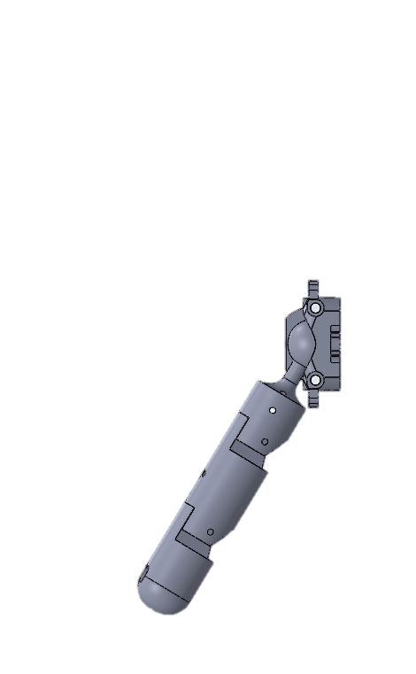
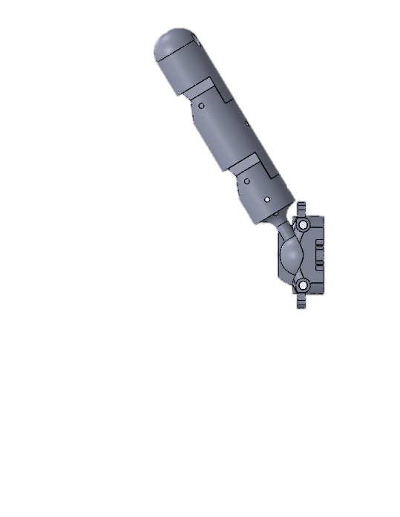
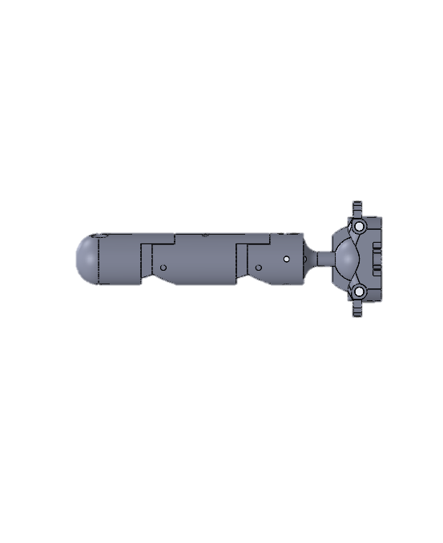
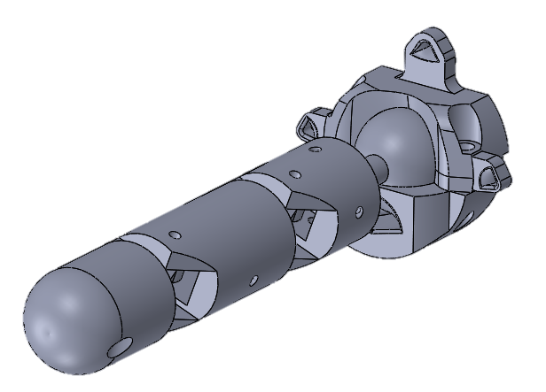
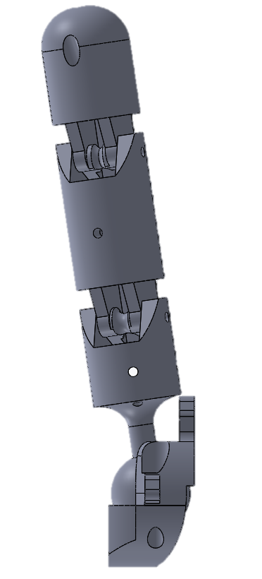
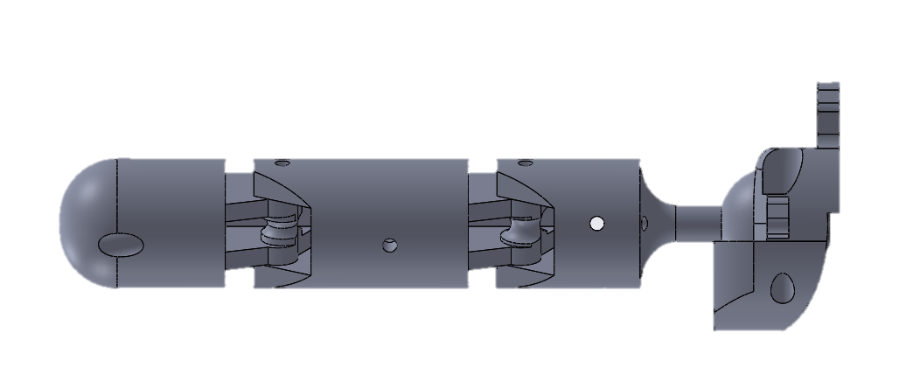
Method - Thumb
TMC
MCP
55⁰
IP
80⁰
55⁰
Tendons
Palmar Abduction
78⁰
Palmar Adduction
Palmar
Radial Abduction
Ethohand I = 30⁰
Radial Adduction
78⁰
Radial
Thumb = 4DoF = 8 Tendons
Ethohand I = ±60⁰
Notes:
The trapezial metacarpal (TMC) joint at the base of thumb has 2 Dof for the palmar and radial abduction. In terms of the radial abduction the new design has a similar range to the original but the major improvement comes in the increase in range in the palmar abduction at 80deg. There are 4 tendons controlling the TMC joint working in pairs as agonist and antagonist tendons. There are also 2 tendons for the MCP and IP for the flexion/extension of each joint. So the thumb has 4 DoF and 8 tendons.

Slide 7
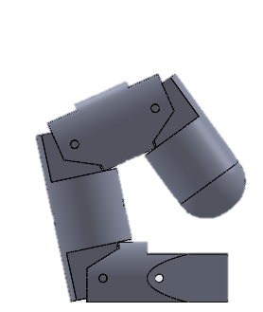
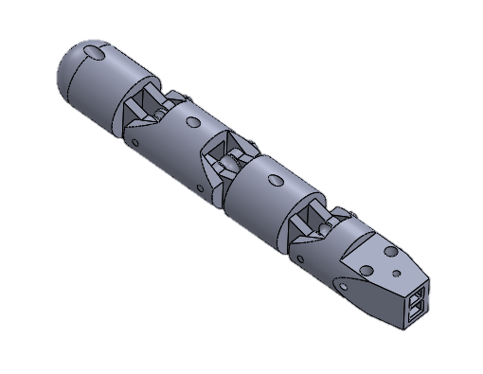
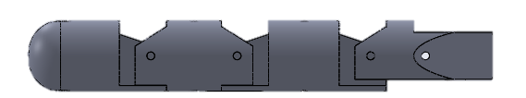
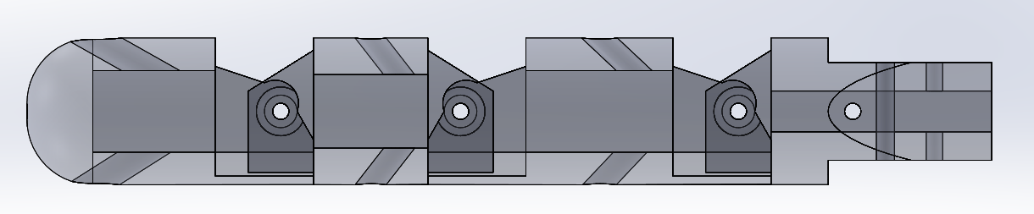
Method - Fingers
78⁰
78⁰
78⁰
DIP
PIP
MCP
Flexion
Extension
Finger = 3 DoF = 6 Tendons
Notes:
Now the design of the finger is similar to the original ethohand except now instead of the joint being coupled, they are fully actuated. This increases the dexterity of the hand. Each joint has 78deg range. There was a trade off between having abduction of the motors and further complicating the control elements of the hand thus I decided to have the fully actuated 3 DoF of the finger which amount to 6 tendons.

Slide 8
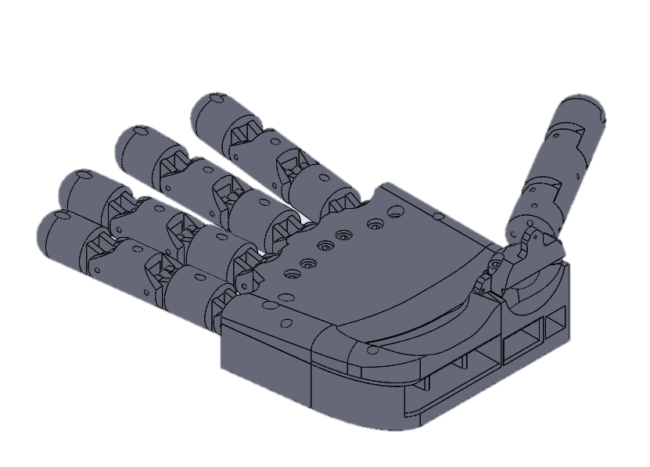
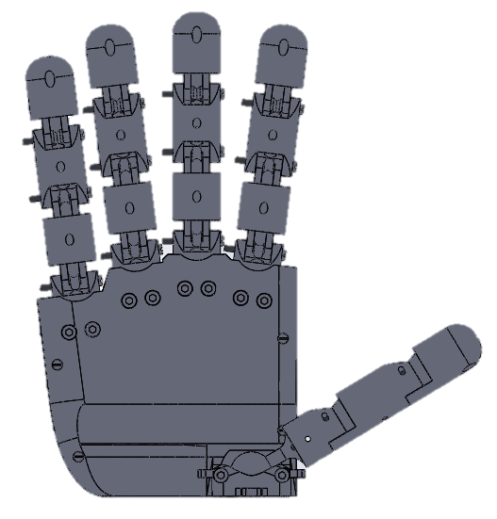
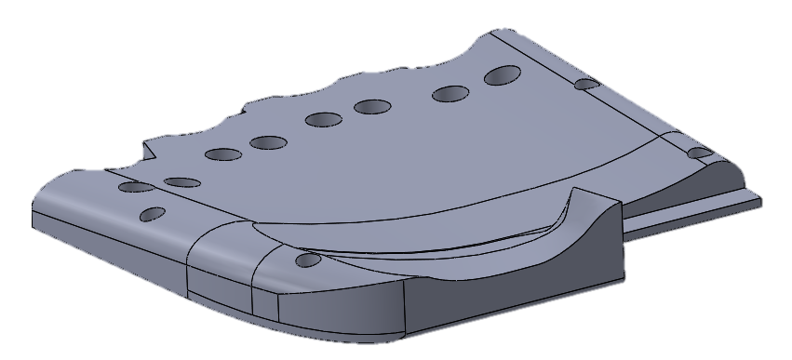
Method - Palm
184mm
Soft, Curved Palm Surface
Better Grasping
Notes:
The design of the palm is very important when it comes to grasping. Thus a more pronounced curvature of the palm compared to the original ethohand was designed. The positioning of the fingers within the palm were designed similar to the human hand by staggering the positions of the MCP and since the fingers have no abduction, an angle that allowed closing of the fingers when flexed was introduced. All of these features designed to aid grasping and anthropomorphism.

Slide 9
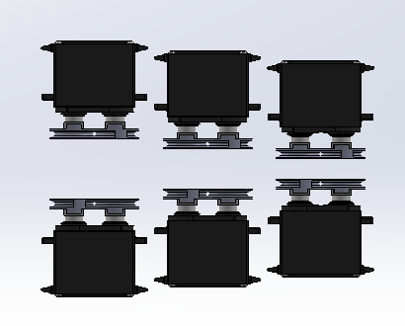
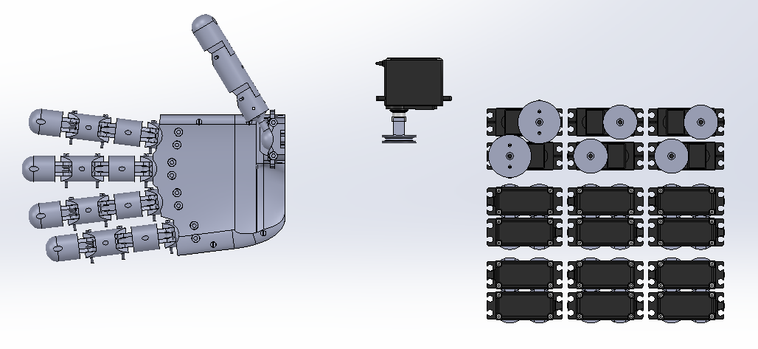
Method – Motor Arrangement
Side View
Top View
Thumb
Index
Middle
Ring
Little
16 DoF = 32 Tendons = 32 Servos
Notes:
All the tendons coming from the fingers and thumb pass through the palm and are connected to a pulley attached to a servo motor. 6 tendons for each finger and 8 for the thumb sums to 32 tendons and thus 32 servos. Now arranging so many motors in a compact manner became a challenge, which was solved by layering the servo’s of the fingers as shown by the side view. So the hand has 16 DoF with 32 tendons, driven by 32 servos. Then the issue became how do you control the hand and power the motors?

Slide 10
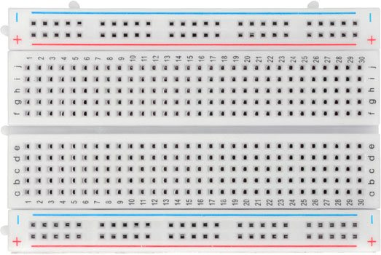
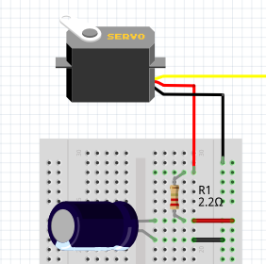
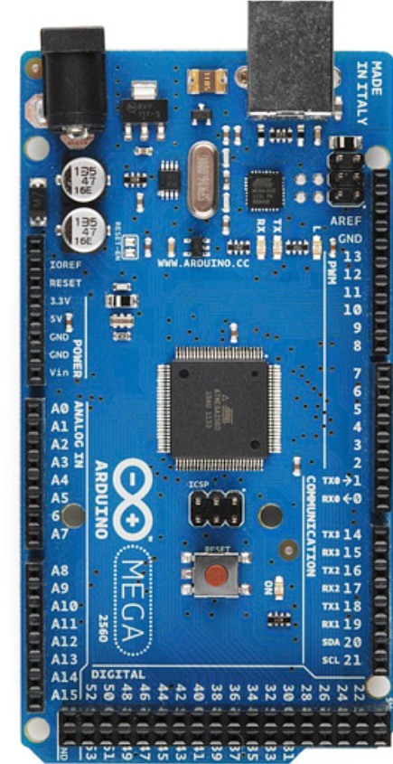
Method – Electronics and Control
3 x 6V, 3A Bench Power Supplies
32 x Hitec HS-422 Servos
32 x Capacitors (1/ Servo)
Arduino Mega 2560
Matlab GUI → Arduino
PC
6V Bench Power Supply
Live
Ground
Signal
Arduino Mega 2560
Notes:
For each motor, 6V was supplied via a bench power supply, connected in parallel to a capacitor to reduce the voltage drop caused by the initial movement of the motors. The motors receive a signal from the Arduino Mega which is powered by the PC. Each motor is controlled through direct input of servo angles or through a slider on GUI created on matlab. So all of this culminated in the final design of the robotic hand which was built to be the Ethohand II.

Slide 11
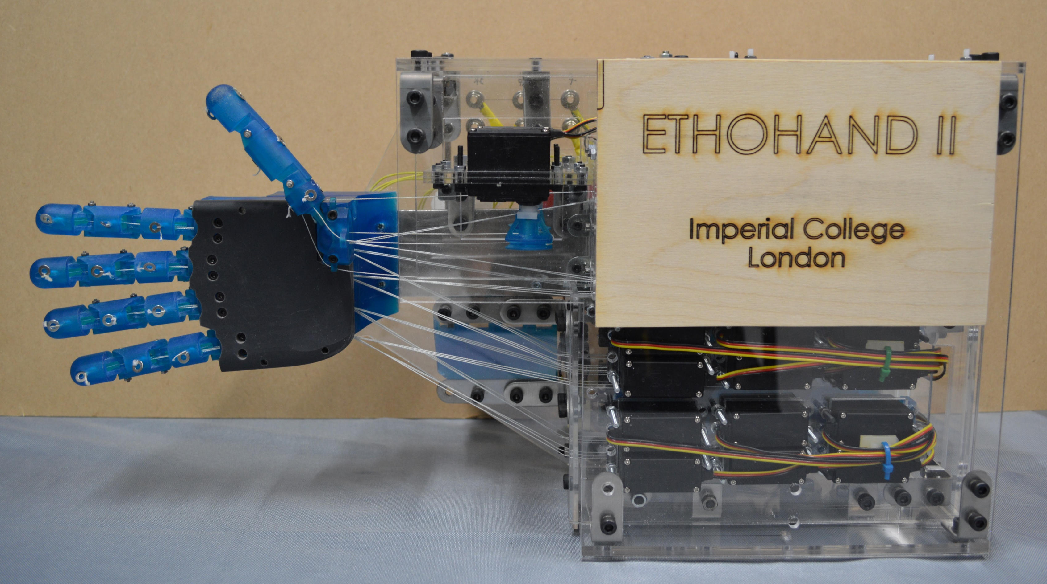
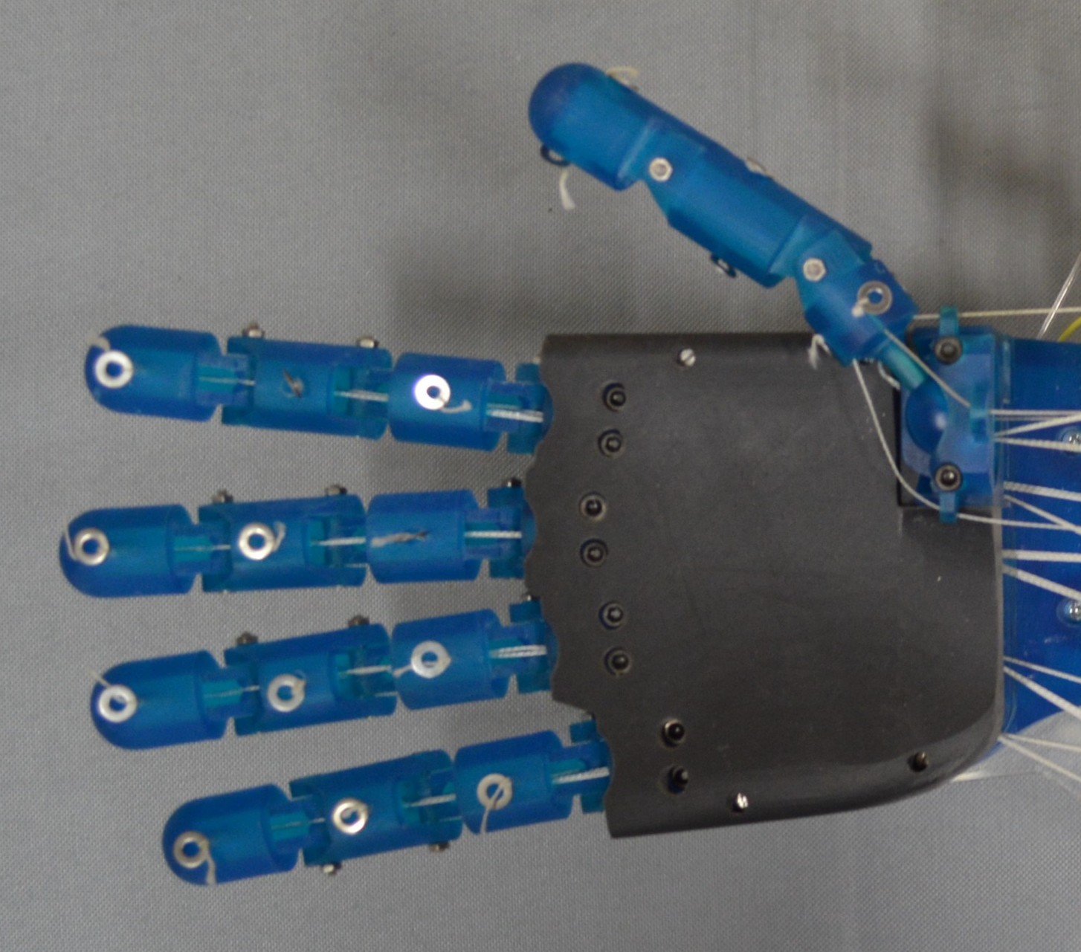
Results – Build of Ethohand II
16 DoF
32 Servo Motors
Tendon Driven
3D printed parts: Formlabs Form 2
Tough V5 Resin → Fingers, Thumb, Pulleys, Palm Base
Flexible V2 Resin → Palm Top
Steel alloy brackets
3mm Acrylic sheets
Notes:
The first objective was to design and build the ethohand 2 and here are some pictures of said robot hand. Parts were printed using the Formlabs Form 2 3d printer. Most by the tough V5 resin. The top of the palm in black was printed in a flexible resin for a softer and grippier palm to assist grasping. The motors, wiring and Arduino are all incased within 3mm acrylic sheets held by steel brackets. So the Ethohand 2 has 16 DoF and actuation, using 32 servos and is tendon driven.

Slide 12
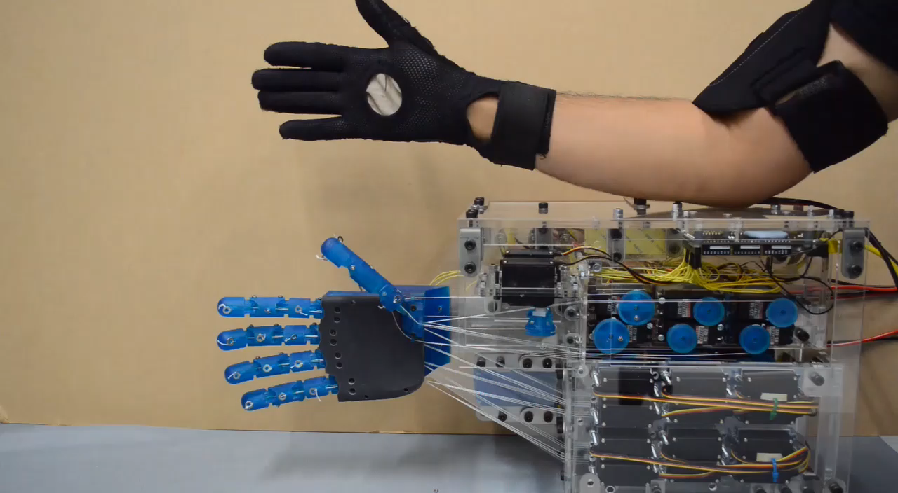
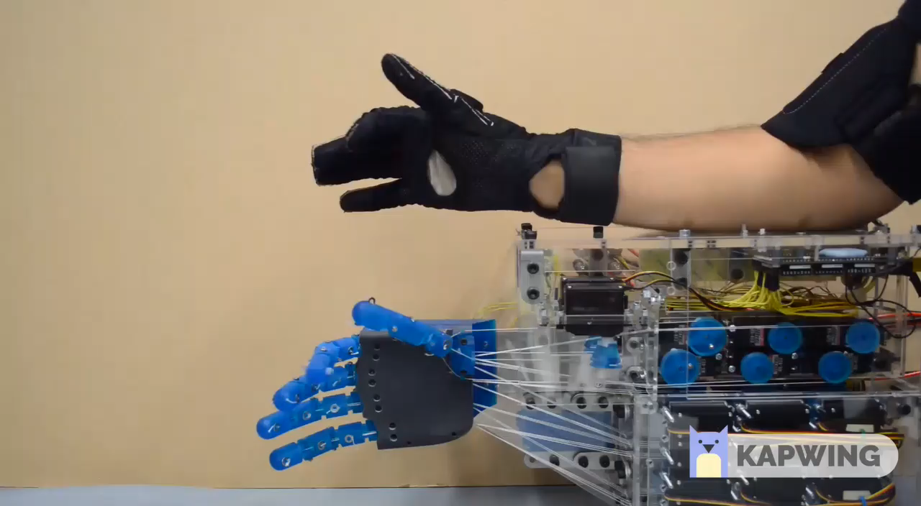
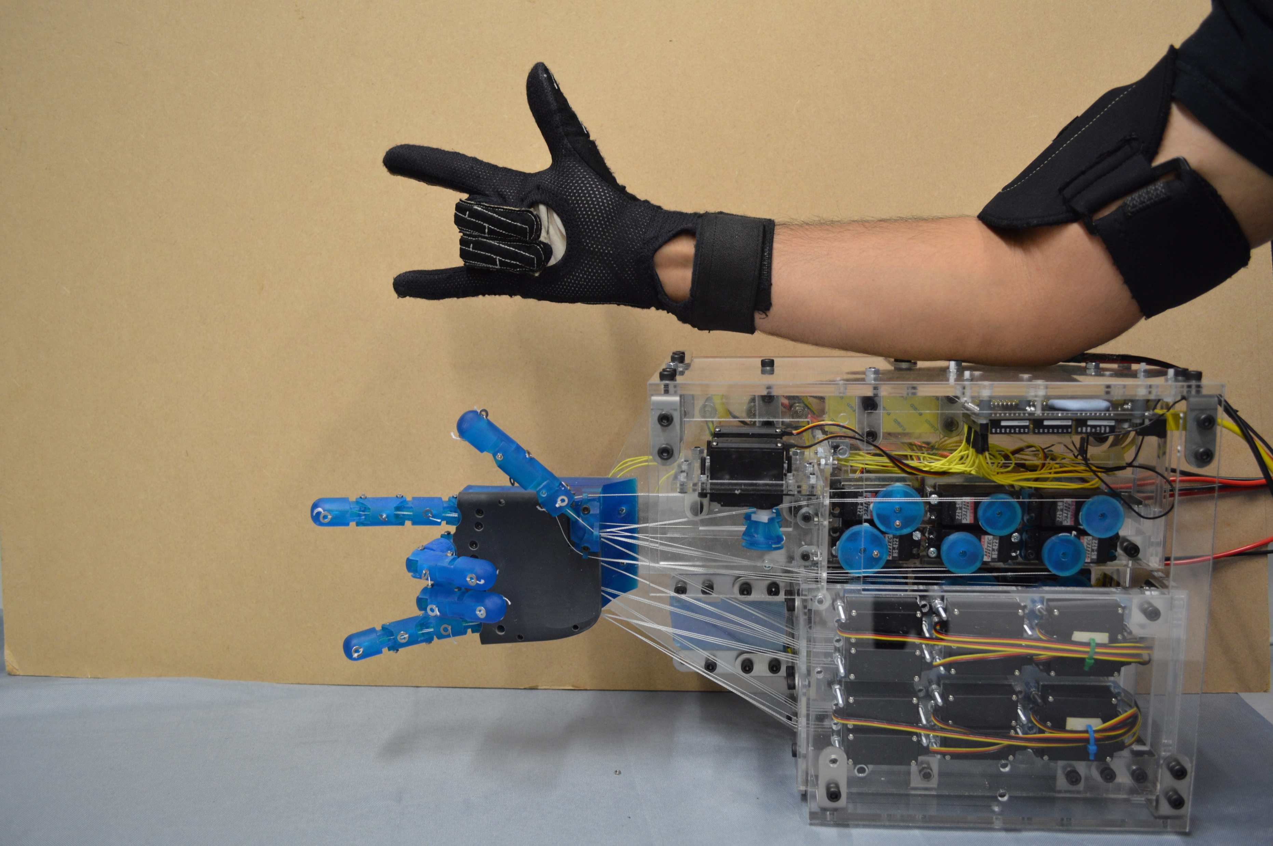
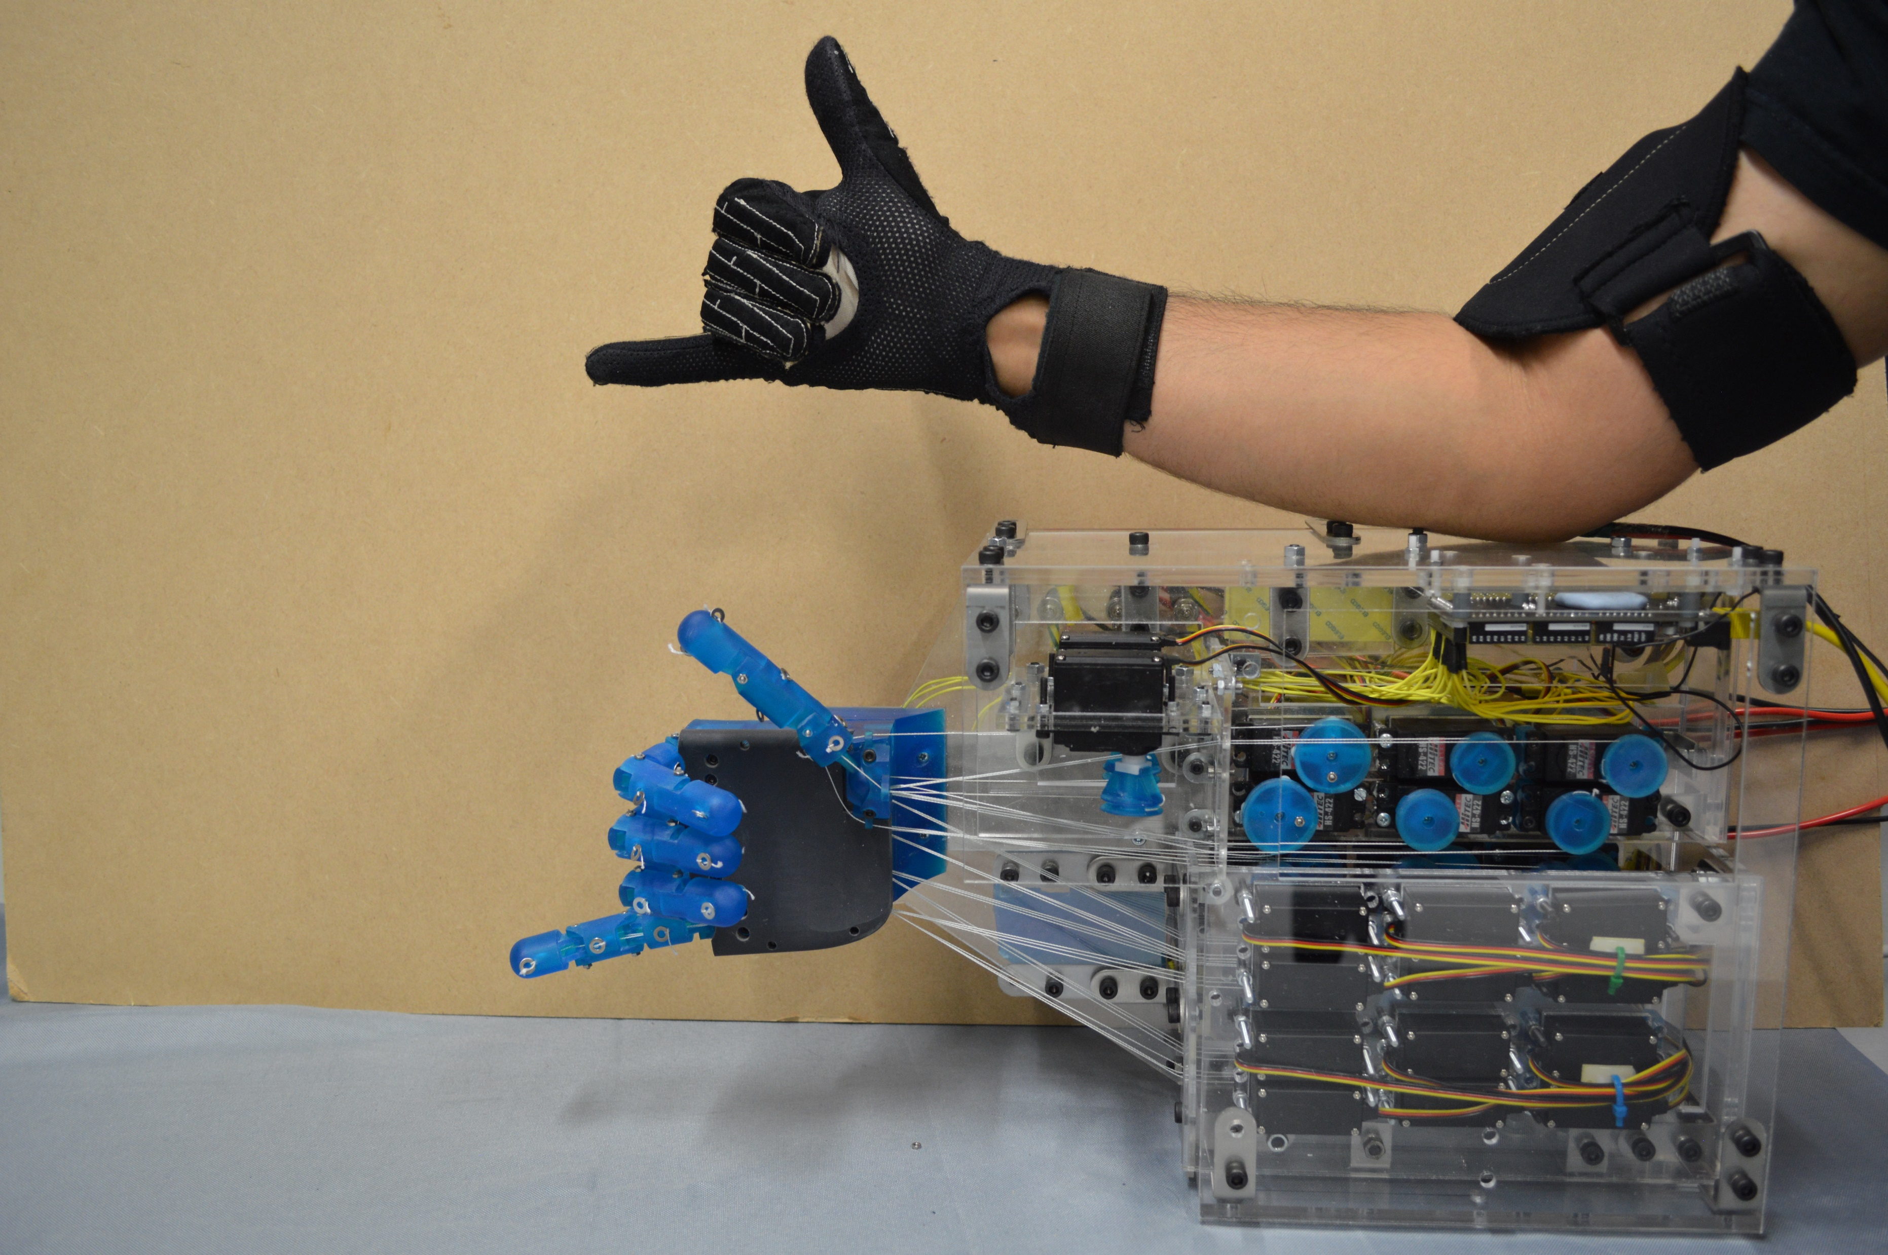
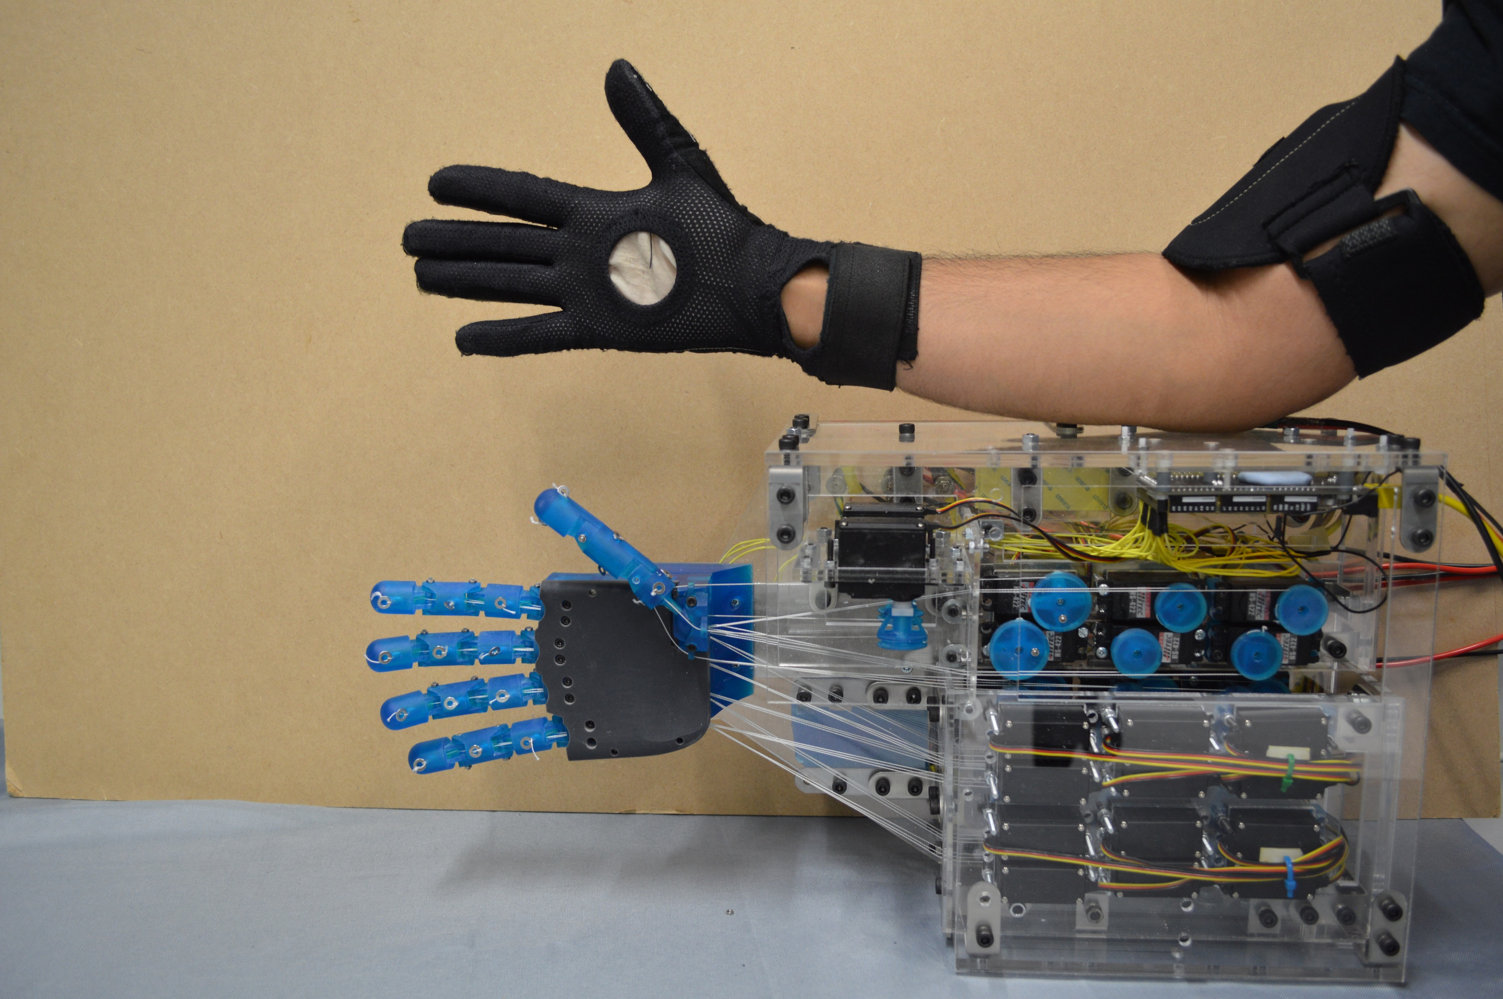
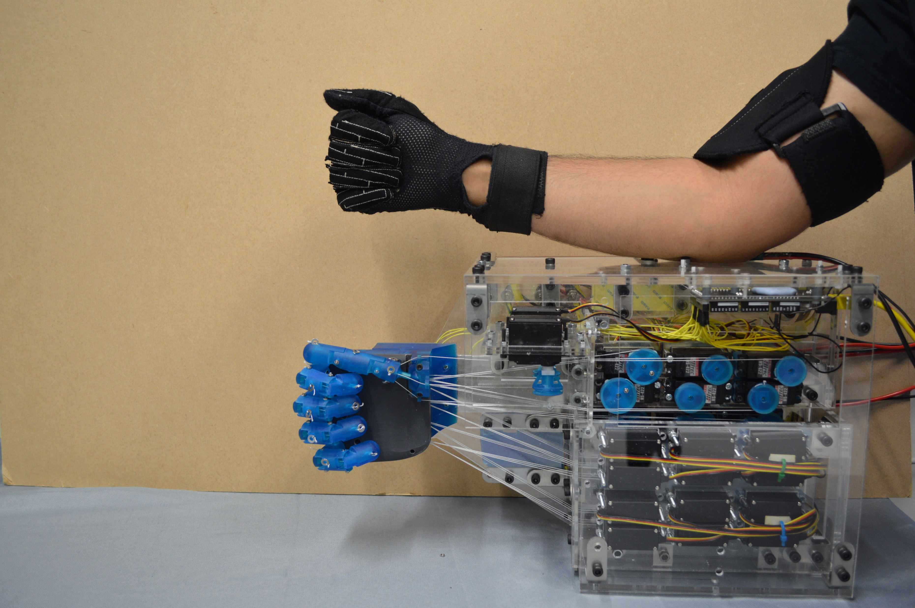
Results – Motions through Teleoperation
Joint Motions
Fingertip Touch
Poses
x1.5
Notes:
From building the hand to teleoperating it using the Cyberglove. Video on the left shows some of the motions of the fingers and thumb. The video on the right is a common movement to test opposition of the thumb by touching each of the fingertips with the thumb. From these we can see that the ball joint is a pretty good representation of the human thumb.

Slide 13
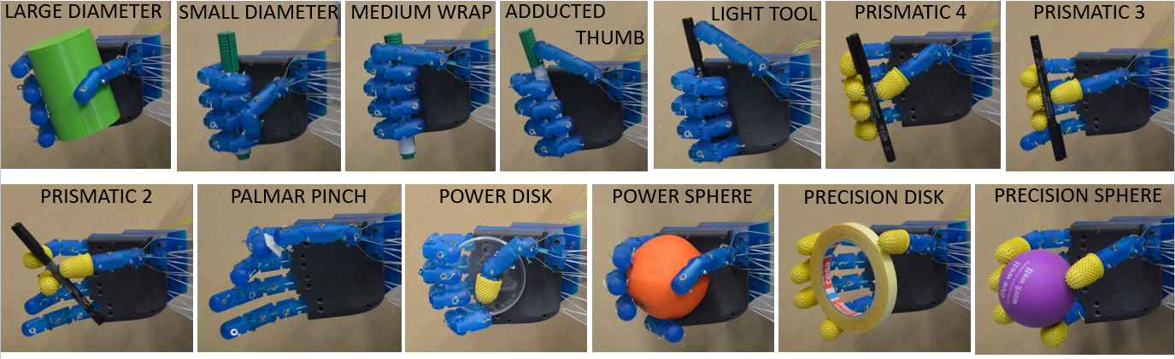
Results – Grasp Taxonomy
33 main grasps [6]
3 Types: Power, Intermediate, Precision
Ethohand II accomplished 29/33 grasps → Other required finger abduction or palm flexion
[6] T. Feix et al.,"The GRASP Taxonomy of Human Grasp Types," in IEEE Transactions on Human-Machine Systems, vol. 46, no. 1, pp. 66-77, Feb. 2016
Notes:
From the motions and hand poses we move on to the grasp taxonomy. Feix and others categorised 33 of the main grasps into 3 types: Power, intermediate and precision and it became the benchmark for the grasps robot hands try to achieve. The ethohand II achieved 29/33 grasps missing out on the others due to the lack of finger abduction and palm flexion. Here are only some of the grasps it achieved.

Slide 14
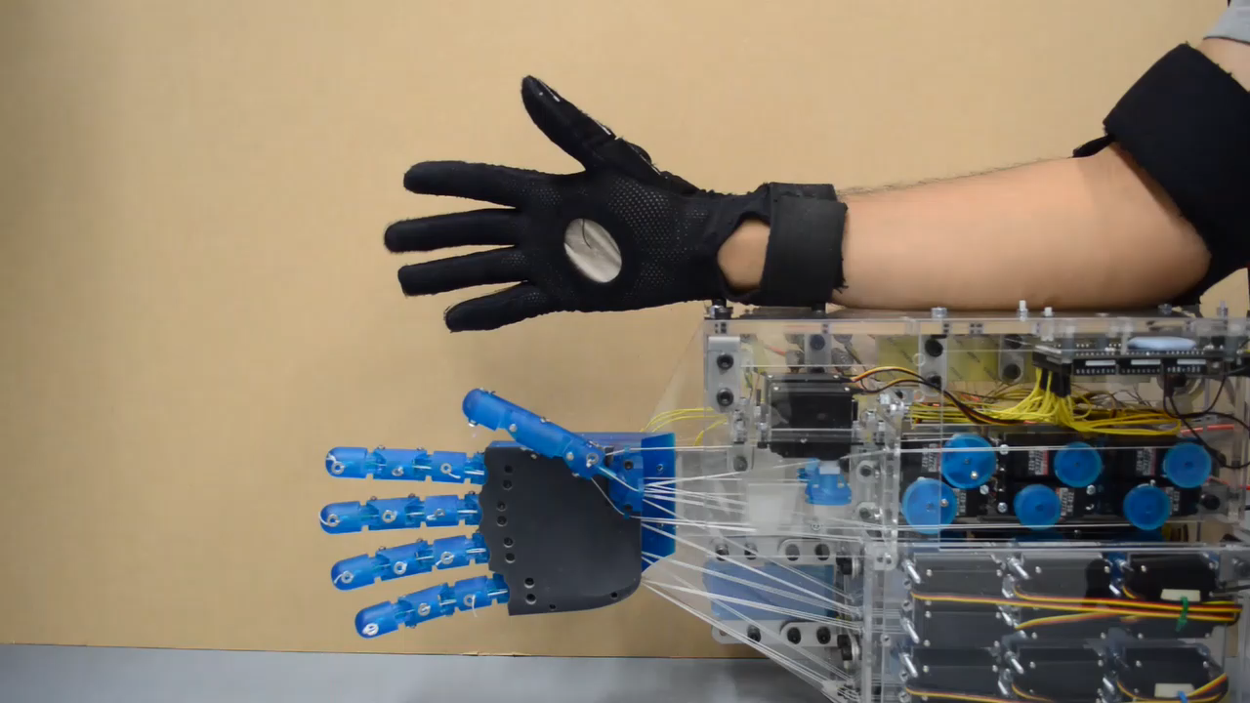
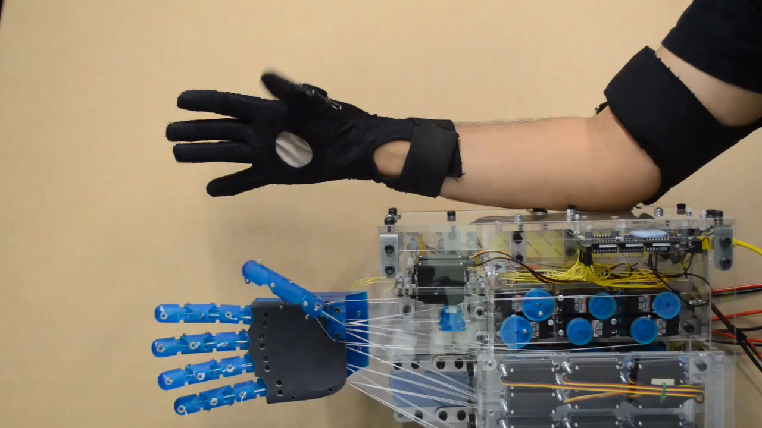
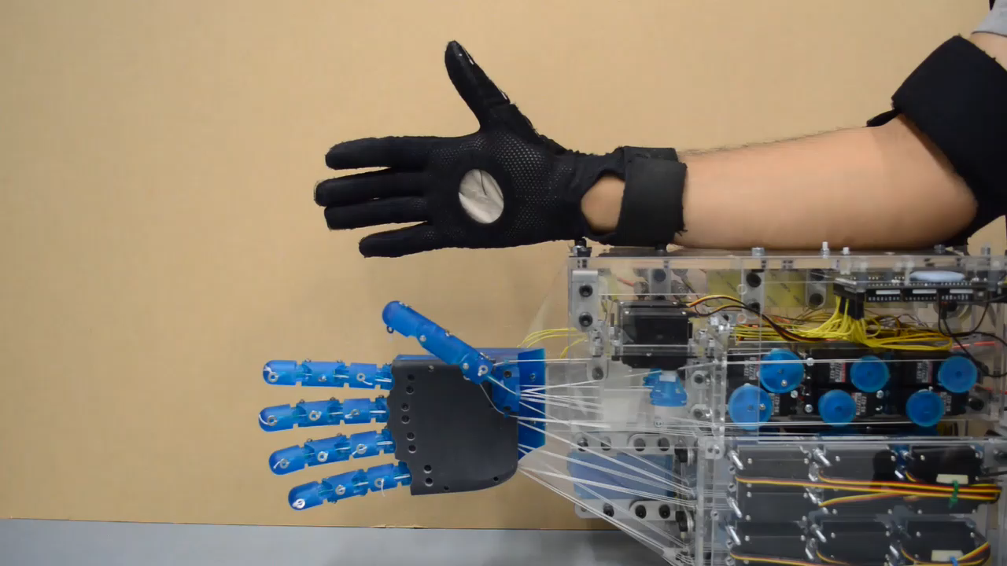
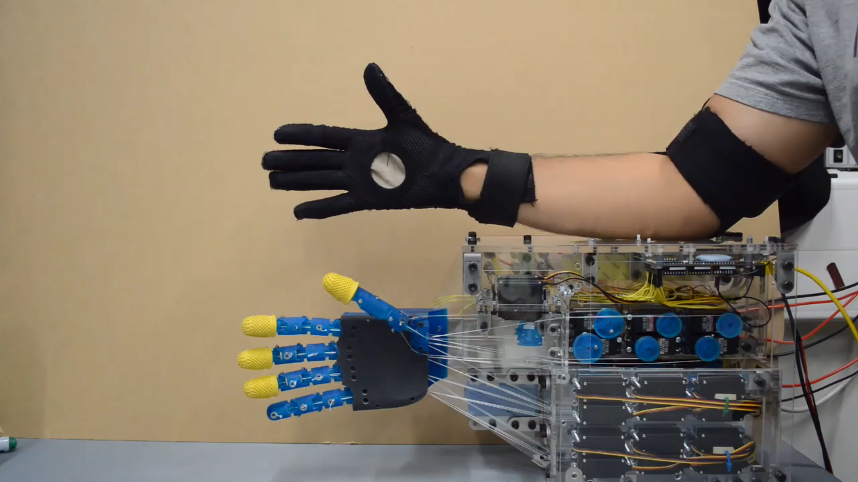
Results – Grasp Taxonomy
TRIPOD
SPHERE 3 FINGER
LATERAL
QUADPOD
Notes:
Here are some other grasps achieved by teleoperation.
Now grasps, motions and poses are well and good to see what the robotic hand can achieve, but they are not measures of dexterity as this requires functionality and object manipulation

Slide 15
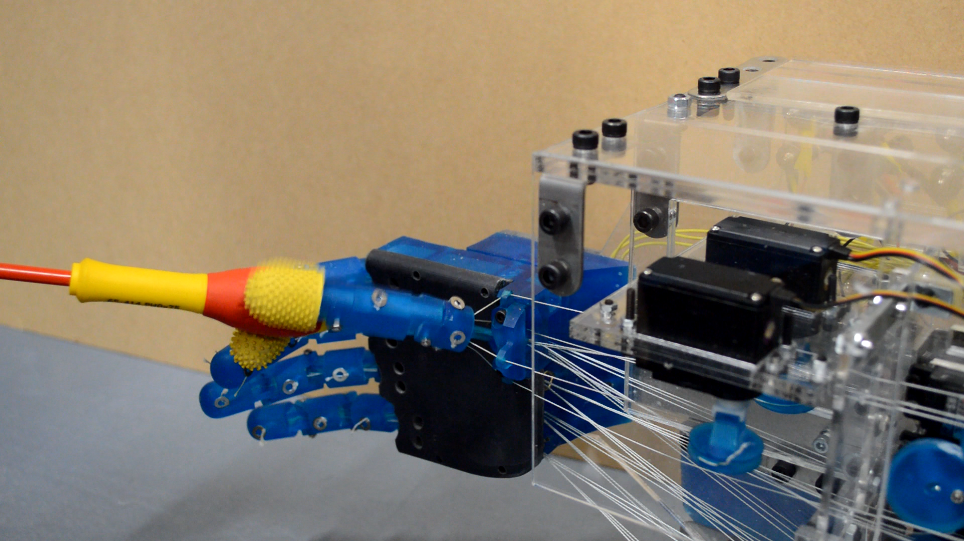
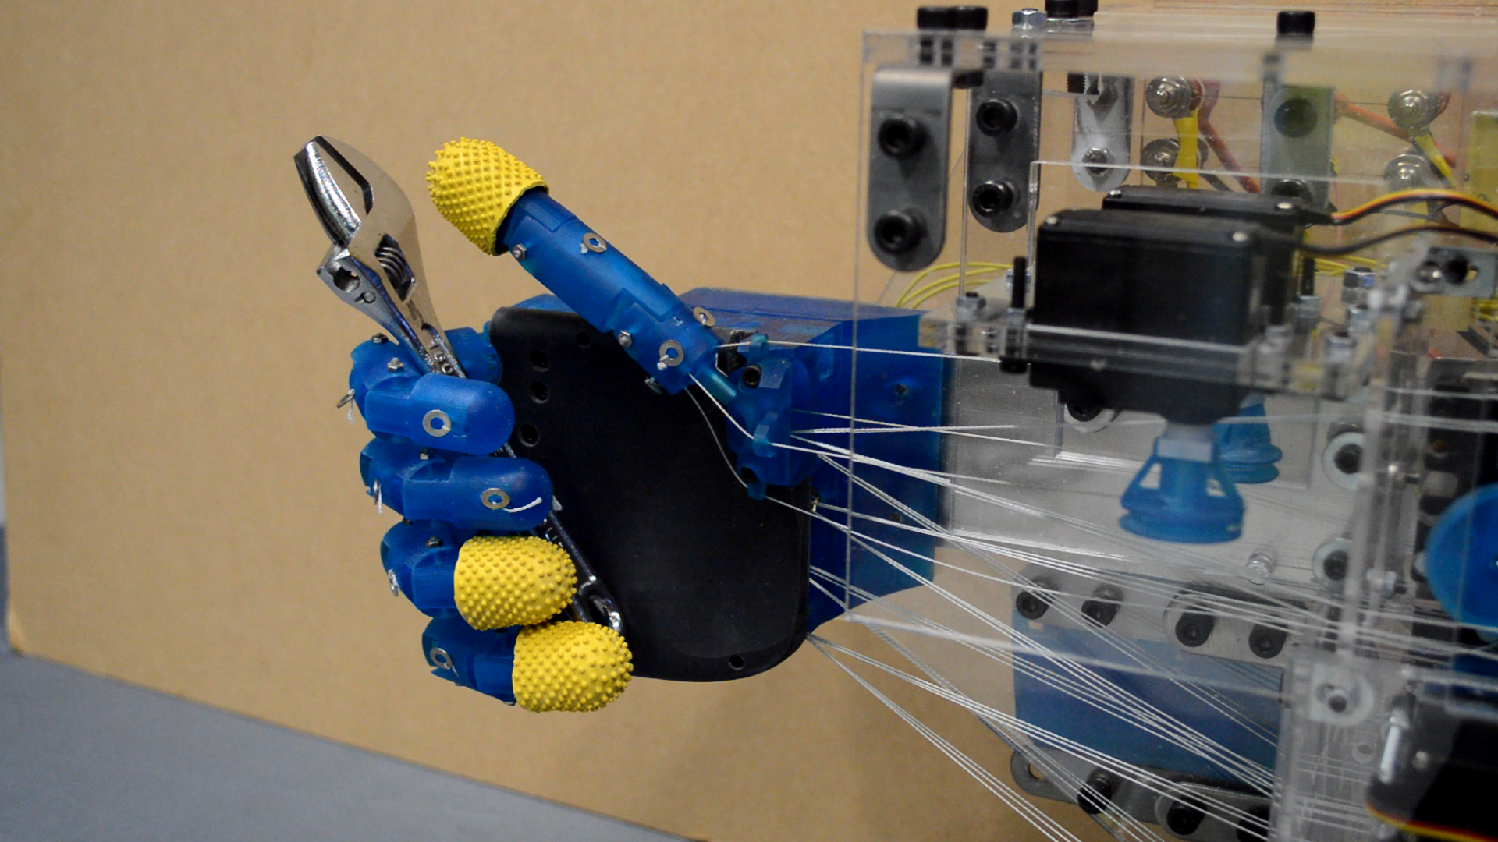
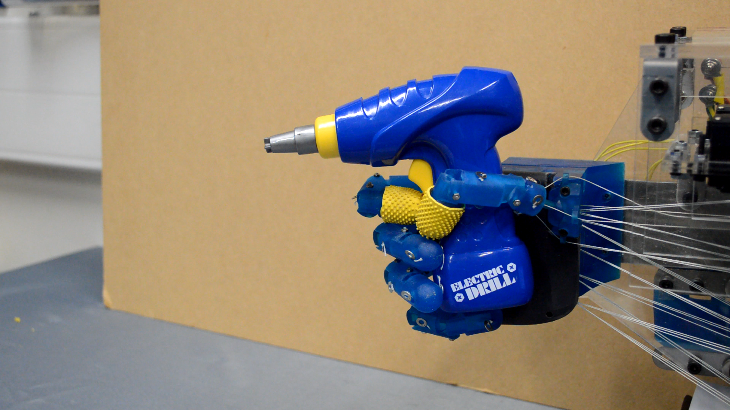
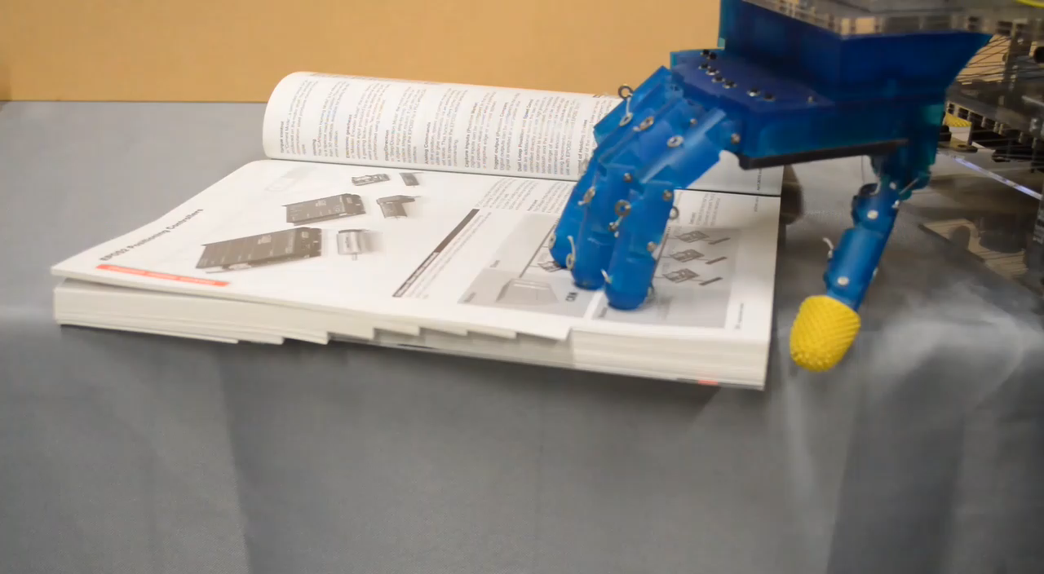
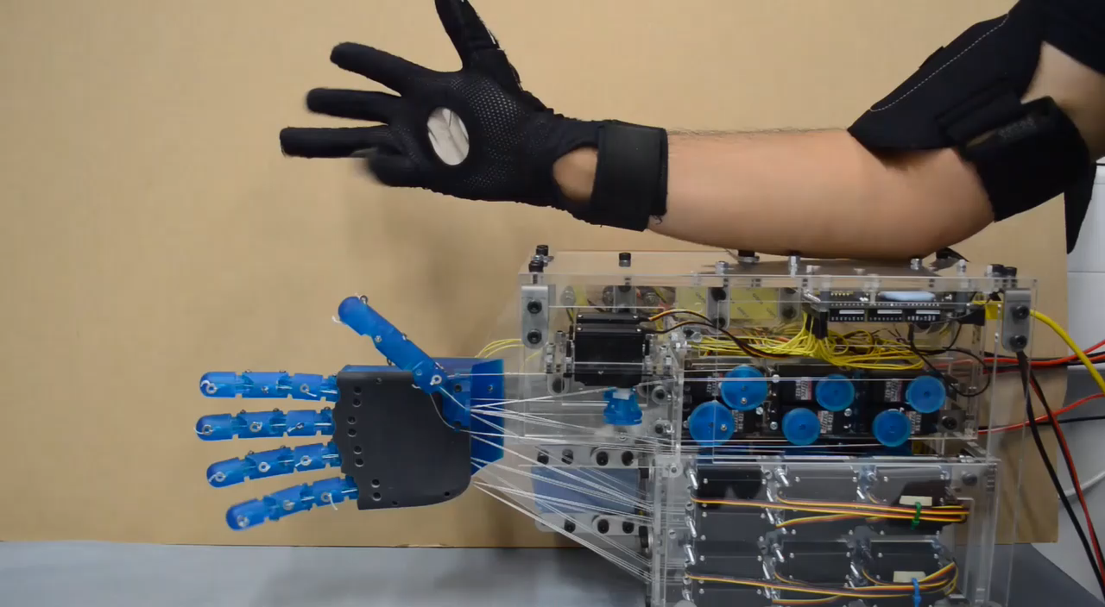
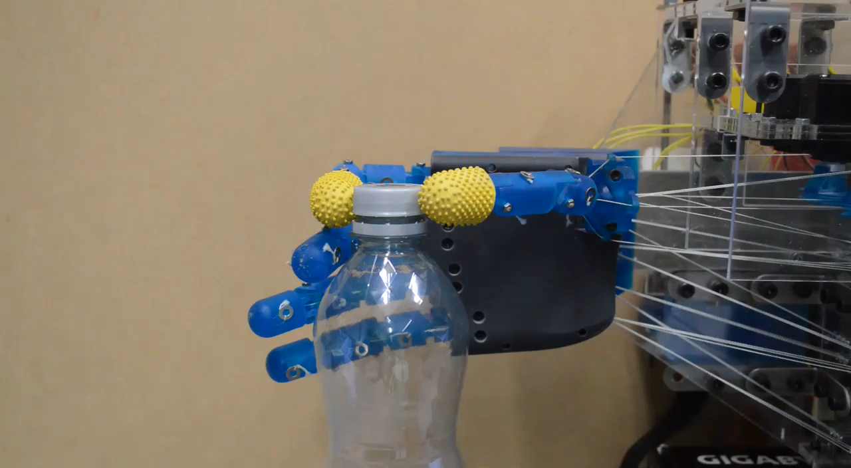
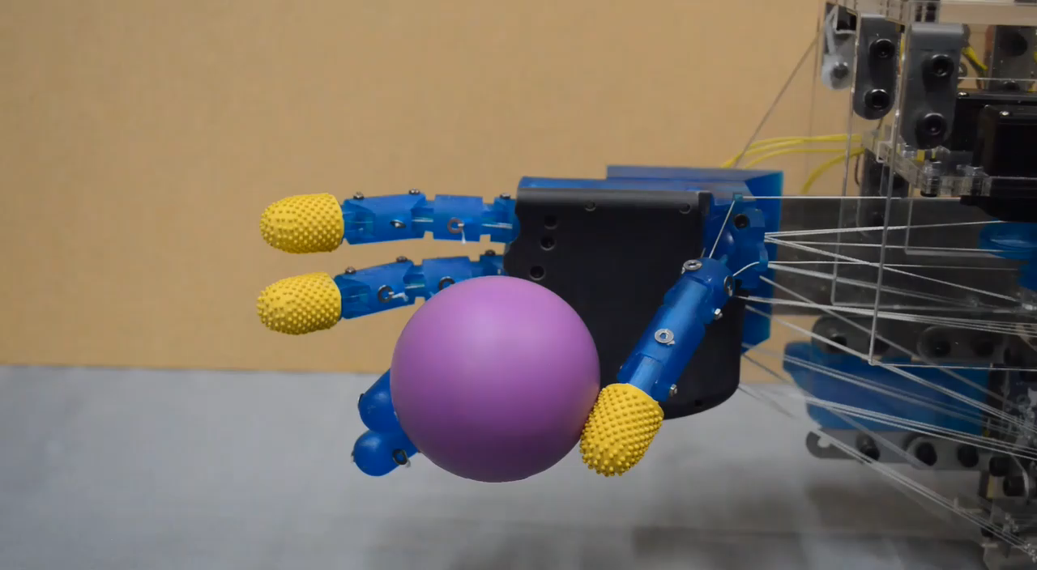
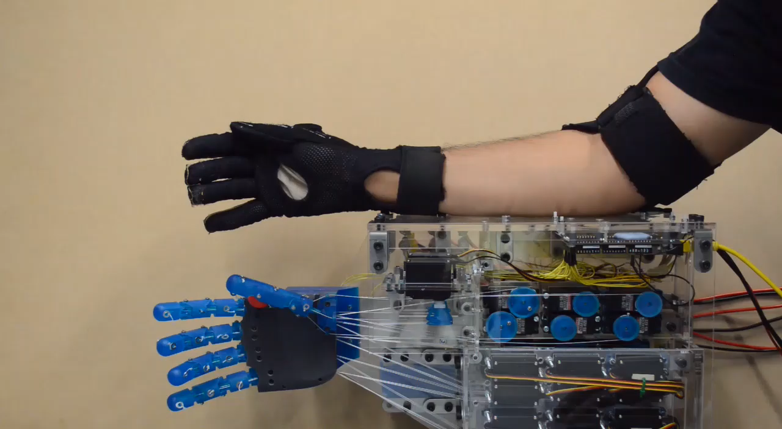
Results – Object Manipulation
SCREWDRIVER
WRENCH OPEN
DRILL
FLICKING PAGES
FINGERS CURLING
BOTTLE OPEN
BALL ROLL
CATCH SMALL BALL
Notes:
Here are some examples of tasks we take for granted everyday such as flicking through pages or using a screwdriver, but are far from trivial for robotic hands.
However grasping and object manipulation are not quantitate measures for evaluating a robotic hand

Slide 16
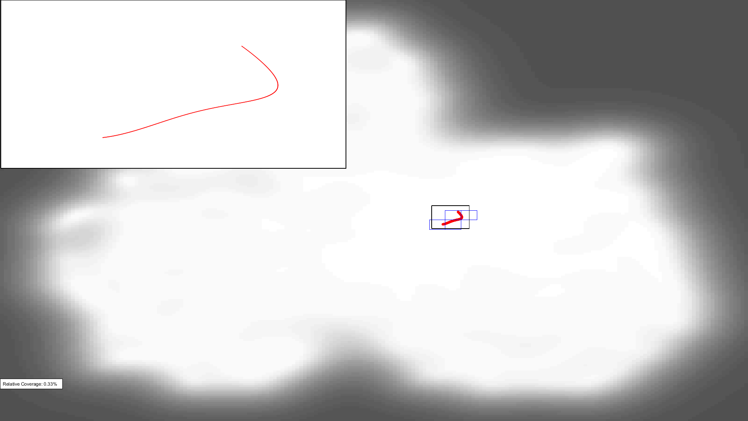



Results – Comparison: GPL Toolbox [7]
AI = Anthropomorphic
Index
Human hand in latent space
Sensor Hand: AI = 0.33%
Hiro III Hand [8]: AI = 14.76%
Shadow Hand: AI = 20.11%
Ethohand II: AI = 18.52%
[7] T. Feix et al, "A Metric for Comparing the Anthropomorphic Motion Capability of Artificial Hands," in IEEE Transactions on Robotics, vol. 29, no. 1, pp. 82-93, Feb. 2013.
[8] T. Endo et al., "Five-fingered haptic interface robot: HIRO III," World Haptics 2009 - Third Joint EuroHaptics conference and Symposium on Haptic Interfaces for Virtual Environment and Teleoperator Systems, Salt Lake City, UT, 2009
Notes:
For that Feix and others developed a toolbox that maps the fingertip positions in different grasps into a latent space to compare with the latent space of the human hand shown in white in each graph. The amount of coverage in this space is the anthropomorphic index
The first graph is of the sensor hand which only has open and closing of the hand which is explains its low AI score. The Ethohand II achieved an AI close to the shadow hand, known to the state of the art in robotic hands.
But this index comes with its limitations as it is a comparison to the human hand in terms of anthropomorphism and not dexterity, only taking into account the endpoints of the digits, neglecting redundancies of other joints.

Slide 17


Results – Comparison: Convex Hulls [9]
MCP
PIP
DIP
Coverage compared to volume of average human finger/thumb (100% = Same coverage as human finger/thumb)
Total Volume of human finger = 353.99 cm³
Total Volume of human thumb = 975.69 cm³
Dimensioned scaled to average human finger/thumb lengths
 | Etho II Hand |  | Shadow Hand |  | Hiro III Hand
 | Index | Thumb | Index | Thumb | Index | Thumb
Total Volume (cm³) | 112.17 | 997.17 | 195.45 | 842.80 | 295.15 | 863.93
% Coverage | 31.53 | 95.52 | 55.13 | 83.58 | 83.38 | 63.85
[9] M. V. Liarokapis et al., “Quantifying anthropomorphism of robot hands,” IEEE ICRA, pp. 2041–2046, 2013
Notes:
So instead of the AI, convex hulls are used to measure the volume of the workspace of the finger and thumb and comparing it to the human finger/thumb workspace. For the fingers the Ethohand only covers 32.5% of the human workspace due to its lack of abduction/adduction and extension which the Hiro III hand fingers have. But the main achievement here is the 95.5% coverage in workspace for the thumb which shows how similar it is to the human thumb.

Slide 18
Conclusion
Ethohand II ball-joint thumb:
80° palmar abduction/adduction
95.5% coverage of human thumb workspace
29/33 grasps in the grasp taxonomy
Other required finger abduction or palm flexion
Capable of object manipulation
Screwdriver, drill, rolling ball, opening bottle
Dimensionality reduction in the real world
Notes:
In conclusion, the aims of the project were met. The Ethohand II balljoint improve the palmar abduction and thus the workspace coverage of the human thumb in comparison to the Ethohand I. It achieves 29 of the 33 main grasps missing out due to the lack of finger abduction. As the videos showed it is capable of various manipulation tasks and there is a proof of concept for dimensionality reduction techniques being applied in the realworld in real time.

Slide 19

Thank You Questions?

